Slide 1
Chapter 5:-
Message Authentication and
Hash Functions
Compiled By:- Akash Mehta
GIT
Notes:
Akash Mehta

Slide 2
Outline
Authentication Requirement,
Functions, Message Authentication Code, Hash Functions,
Security Of Hash Functions And Macs
MD5 Message Digest Algorithm,
Secure Hash Algorithm
Ripemd-160
Hmac
Akash Mehta

Slide 3
Authentication Requirements
Disclosure: Release of message contents to any person or process not possessing the appropriate cryptographic key.
Traffic analysis: Discovery of the pattern of traffic between parties. In a connection-oriented application, the frequency and duration of connections could be determined. In either a connection-oriented or connectionless environment, the number and length of messages between parties could be determined.
Masquerade: Insertion of messages into the network from a fraudulent source. This includes the creation of messages by an opponent that are supposed to come from an authorized entity. Also included are fraudulent acknowledgments of message receipt or nonreceipt by someone other than the message recipient.
Akash Mehta

Slide 4
Contd…
Content modification: Changes to the contents of a message, including insertion, deletion, transposition, and modification.
Sequence modification: Any modification to a sequence of messages between parties, including insertion, deletion, and reordering.
Timing modification: Delay or replay of messages. In a connection-oriented application, an entire session or sequence of messages could be a replay of some previous valid session, or individual messages in the sequence could be delayed or replayed. In a connectionless application, an individual message (e.g., datagram) could be delayed or replayed.
Akash Mehta

Slide 5
Contd…
Source repudiation: Denial of transmission of message by source.
Destination repudiation: Denial of receipt of message by destination.
Akash Mehta

Slide 6
Message Authentication Function
message authentication is concerned with:
  protecting the integrity of a message
  validating identity of originator
  non-repudiation of origin (dispute resolution)
three alternative functions used:
  message encryption
  message authentication code (MAC)
  hash function
Akash Mehta
Notes:
Up untill now, have been concerned with protecting message content (ie secrecy) by encrypting the message. Will now consider how to protect message integrity (ie protection from modification), as well as confirming the identity of the sender. Generically this is the problem of message authentication, and in eCommerce applications is arguably more important than secrecy. Message Authentication is concerned with: protecting the integrity of a message, validating identity of originator, & non-repudiation of origin (dispute resolution). There are three types of functions that may be used to produce an authenticator: message encryption, message authentication code (MAC), or a hash function.

Slide 7
Message Encryption
message encryption by itself also provides a measure of authentication
if symmetric encryption is used then:
  receiver know sender must have created it
  since only sender and receiver now key used
  So, content cannot of been altered
  Provides both: sender authentication and message authenticity.
Akash Mehta
Notes:
Message encryption by itself can provide a measure of authentication. Here, the ciphertext of the entire message serves as its authenticator, on the basis that only those who know the appropriate keys could have validly encrypted the message. This is provided you can recognize a valid message (ie if the message has suitable structure such as redundancy or a checksum to detect any changes).

Slide 8
Message Encryption
if public-key encryption is used:
  encryption provides no confidence of sender
  since anyone potentially knows public-key
  however if
    sender signs message using his private-key
    then encrypts with recipients public key
    have both secrecy and authentication
  but at cost of two public-key uses on message
Akash Mehta
Notes:
With public-key techniques, can get a digital signature which can only have been created by key owner. But at cost of two public-key operations at each end on message.

Slide 9
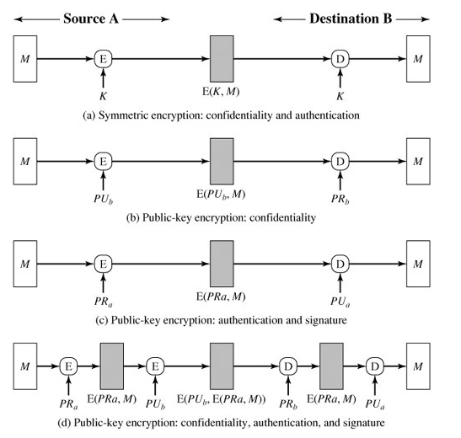
Akash Mehta

Slide 10
Message Authentication Code (MAC)
a small fixed-sized block of data:
  depends on both message and a secret key
  like encryption though need not be reversible
appended to message as a signature
receiver performs same computation on message and checks it matches the MAC
provides assurance that message is unaltered and comes from sender
Akash Mehta
Notes:
An alternative authentication technique involves the use of a secret key to generate a small fixed-size block of data, known as a cryptographic checksum or MAC that is appended to the message. This technique assumes that two communicating parties, say A and B, share a common secret key K. A MAC function is similar to encryption, except that the MAC algorithm need not be reversible, as it must for decryption.

Slide 11
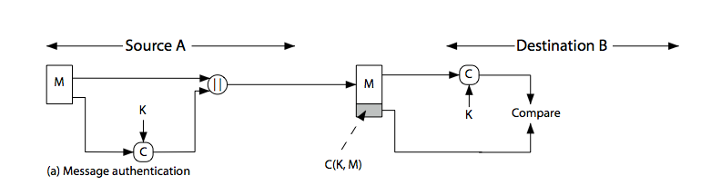
Message Authentication Code
This technique assumes that two communicating parties, say A and B,
share a common secret key K. When A has a message to send to B,
it calculates the MAC as a function of the message and the key:
MAC = C(K, M), where
M= input message
C= MAC function
K= shared secret key
MAC= message authentication code
Akash Mehta
Notes:
Stallings Figure 11.4a “Message Authentication” shows the use of a MAC just for authentication.

Slide 12
Message Authentication Codes
MAC provides authentication
Message can be encrypted for secrecy
  generally use separate keys for each
  can compute MAC either before or after encryption
  is generally regarded as better done before
why use a MAC?
  sometimes only authentication is needed
  sometimes need authentication to persist longer than the encryption
Akash Mehta
Notes:
Can combine use of MAC with encryption in various ways to provide both authentication & secrecy.
Use MAC in circumstances where just authentication is needed (or needs to be kept), see text for examples.
A MAC is NOT a digital signature since both sender & receiver share key and could create it.

Slide 13
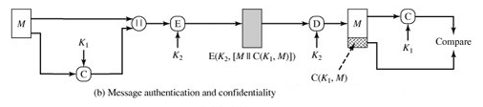
Mac Encryption
The receiver is assured that the message is from the alleged sender. Because no one else knows the secret key, no one else could prepare a message with a proper MAC.
Akash Mehta

Slide 14
MAC Properties
a MAC is a cryptographic checksum
  MAC = C_{K}(M)
  C is a function
  condenses a variable-length message M
  using a secret key K
  to a fixed-sized authenticator
many-to-one function
  potentially many messages have same MAC
  but finding these needs to be very difficult
Akash Mehta
Notes:
A MAC, also known as a cryptographic checksum,is generated by a function C. The MAC is appended to the message at the source at a time when the message is assumed or known to be correct. The receiver authenticates that message by re-computing the MAC.
The MAC function is a many-to-one function, since potentially many arbitrarily long messages can be condensed to the same summary value, but don’t want finding them to be easy!

Slide 15
Requirements for MACs
MAC needs to satisfy the following:
  knowing a message and MAC, is infeasible to find another message with same MAC
  MACs should be uniformly distributed
  MAC should depend equally on all bits of the message
Akash Mehta
Notes:
In assessing the security of a MAC function, we need to consider the types of attacks that may be mounted against it. Hence it needs to satisfy the listed requirements.
The first requirement deals with message replacement attacks, in which an opponent is able to construct a new message to match a given MAC, even though the opponent does not know and does not learn the key.
The second requirement deals with the need to thwart a brute-force attack based on chosen plaintext.
The final requirement dictates that the authentication algorithm should not be weaker with respect to certain parts or bits of the message than others.

Slide 16
Hash Functions
A hash function is like a MAC
condenses arbitrary message to fixed size
  h = H(M)
usually assume that the hash function is public and not keyed
  -note that a MAC is keyed
hash used to detect changes to message
can use in various ways with message
most often to create a digital signature
Akash Mehta
Notes:
A variation on the message authentication code is the one-way hash function. As with the message authentication code, a hash function accepts a variable-size message M as input and produces a fixed-size output, referred to as a hash code H(M). Unlike a MAC, a hash code does not use a key but is a function only of the input message. The hash code is also referred to as a message digest or hash value.

Slide 17
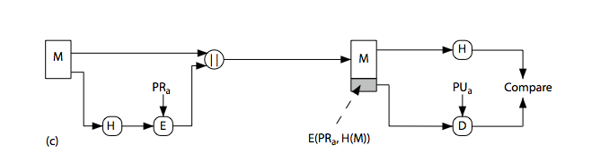
Hash Functions & Digital Signatures
Only the hash code is encrypted, using public-key encryption and using the sender's private key. As with (b), this provides authentication. It also provides a digital signature.
Akash Mehta
Notes:
Stallings Figure 11.5c “Basic Uses of Hash Functions” shows the hash being “signed” with the senders private key, thus forming a digital signature.

Slide 18
Requirements for Hash Functions
can be applied to any size message M
produces a fixed-length output h
is easy to compute h=H(M) for any message M
given h is infeasible to find x s.t. H(x)=h
given x is infeasible to find y s.t. H(y)=H(x)
is infeasible to find any x,y s.t. H(y)=H(x)
Akash Mehta
Notes:
The purpose of a hash function is to produce a “fingerprint "of a file, message, or other block of data.
These are the specifications for good hash functions. Essentially it must be extremely difficult to find 2 messages with the same hash, and the hash should not be related to the message in any obvious way (ie it should be a complex non-linear function of the message). There are quite a few similarities in the evolution of hash functions & block ciphers, and in the evolution of the design requirements on both.

Slide 19
Simple Hash Functions
are several proposals for simple functions
based on XOR of message blocks
-divide the message into equal size blocks
-perform XOR operation block by block
-final output is the hash
not very secure
need a stronger cryptographic function
Akash Mehta
Notes:
All hash functions operate using the following general principles. The input (message, file,etc.) is viewed as a sequence of n-bit blocks, processed one block at a time in an iterative fashion to produce an n-bit hash function. Can construct a range of possible simple hash functions by just XOR’ing blocks with rotates etc. None of these are secure, since can predict how changes to message affect the resulting hash.

Slide 20
Security of Hash Functions and Macs
Attacks on hash functions and MACs into two categories:
  Brute-force attacks
  Cryptanalysis.
Akash Mehta

Slide 21
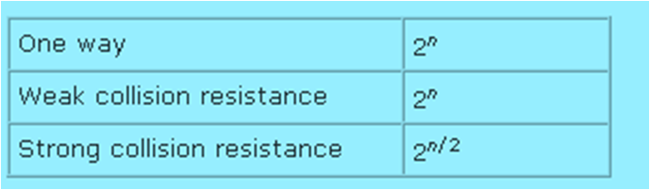
Brute-Force Attacks
Hash Functions:
In hash functions there are three desirable properties
  One-way: For any given code h, it is computationally infeasible to find x such that H(x) = h.
  Weak collision resistance: For any given block x, it is computationally infeasible to find y≠x with H(y) = H(x).
  Strong collision resistance: It is computationally infeasible to find any pair (x, y) such that H(x) = H(y).
For a hash code of length n, the level of effort required, as we have seen is proportional to the following:
Akash Mehta

Slide 22
Contd…
Message Authentication Codes
A brute-force attack on a MAC is a more difficult undertaking because it requires known message-MAC pairs. Let us see why this is so. To attack a hash code, we can proceed in the following way. Given a fixed message x with n-bit hash code h = H(x), a brute-force method of finding a collision is to pick a random bit string y and check if H(y) = H(x). The attacker can do this repeatedly off line. Whether an off-line attack can be used on a MAC algorithm depends on the relative size of the key and the MAC.
Akash Mehta

Slide 23
Contd…
If an attacker can determine the MAC key, then it is possible to generate a valid MAC value for any input x.
Suppose the key size is k bits and that the attacker has one known text-MAC pair. Then the attacker can compute the n-bit MAC on the known text for all possible keys. At least one key is guaranteed to produce the correct MAC, namely, the valid key that was initially used to produce the known text-MAC pair. This phase of the attack takes a level of effort proportional to 2^{k}.
Akash Mehta

Slide 24
Cryptanalysis
As with encryption algorithms, cryptanalytic attacks on hash functions and MAC algorithms seek to exploit some property of the algorithm to perform some attack other than an exhaustive search. The way to measure the resistance of a hash or MAC algorithm to cryptanalysis is to compare its strength to the effort required for a brute-force attack. That is, an ideal hash or MAC algorithm will require a cryptanalytic effort greater than or equal to the brute-force effort.
Akash Mehta

Slide 25
Cryptanalysis
Hash Functions
The hash function takes an input message and partitions it into L fixed-sized blocks of b bits each. If necessary, the final block is padded to b bits. The final block also includes the value of the total length of the input to the hash function. The inclusion of the length makes the job of the opponent more difficult.
Message Authentication Codes
There is much more variety in the structure of MACs than in hash functions, so it is difficult to generalize about the cryptanalysis of MACs. Further, far less work has been done on developing such attacks.
Akash Mehta

Slide 26
Message Digests(Hash)
A message digest is a fingerprint or the summary of a message. (Same as LRC and CRC)
It is used to verify integrity of the data (To ensure that message has not been tampered).
Ex. LRC- parity checking
Akash Mehta

Slide 27
Idea of a Message Digest
Ex: Calculate the message digest of number 7391743
Multiply each digit in the number with the next digit (excluding if it is 0) and disregarding the first digit of the multiplication operation, it the result is two-digit number.
Akash Mehta

Slide 28
Calculate MD for 7391743
Multiply 7 by 3 - 21
Discard first digit - 1
Multiply 1 by 9 - 9
Multiply 9 by 1 - 9
Multiply 9 by 7 - 63
Discard first digit - 3
Multiply 3 by 4 - 12
Discard first digit - 2
Multiply 2 by 3 - 6
  Message digest is 6
Akash Mehta

Slide 29
MD5 (Message Digest 5)
MD5 is a message digest algorithm developed by Ron Rivest.
MD5 algorithm can be used as a digital signature mechanism.
Akash Mehta

Slide 30
Description of the MD5 Algorithm
Takes as input a message of arbitrary length and produces as output a 128 bit “fingerprint” or “message digest” of the input.
It it is computationally infeasible to produce two messages having the same message digest.
Intended where a large file must be “compressed” in a secure manner before being encrypted with a private key under a public-key cryptosystem such as PGP.
Akash Mehta

Slide 31
MD5 Algorithm
Suppose a b-bit message as input, and that we need to find its message digest.
Step-1 Padding
Step-2 Append length
Step-3 Divide the input into 512-bit blocks.
Step-4 Initialize chaining variables (4 variables)
Step-5 Process blocks
Akash Mehta

Slide 32
Step-1
MD5 is to add padding bits to the original message.
The aim of this step is make length of the original message equal to a value, which is 64 bits less than an exact multiple of 512.
Ex: 1000 bits of message (1000+472+64)
The padding consists of a single “1” bit is appended to the message, and then “0” bits.
Akash Mehta

Slide 33
Step 2 – append length:
A 64 bit representation of b is appended to the result of the previous step.
The resulting message has a length that is an exact multiple of 512 bits
Akash Mehta

Slide 34
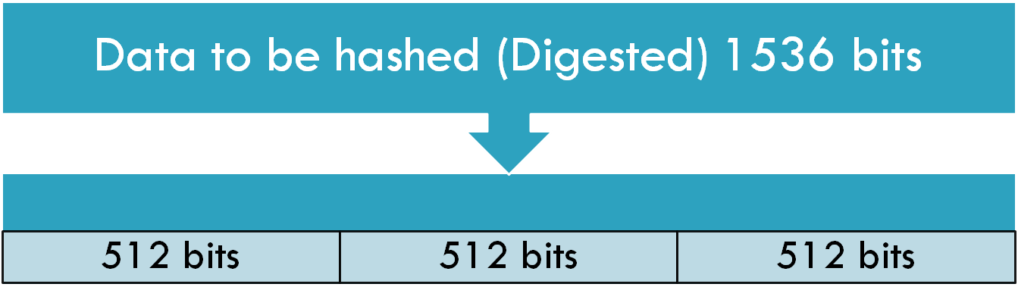
Step-3 Divide the input into 512-bit blocks
Akash Mehta

Slide 35
Step-4 Initialize chaining variables
A four-word buffer (A,B,C,D) is used to compute the message digest.
Here each of A,B,C,D, is a 32 bit register.
Akash Mehta

Slide 36
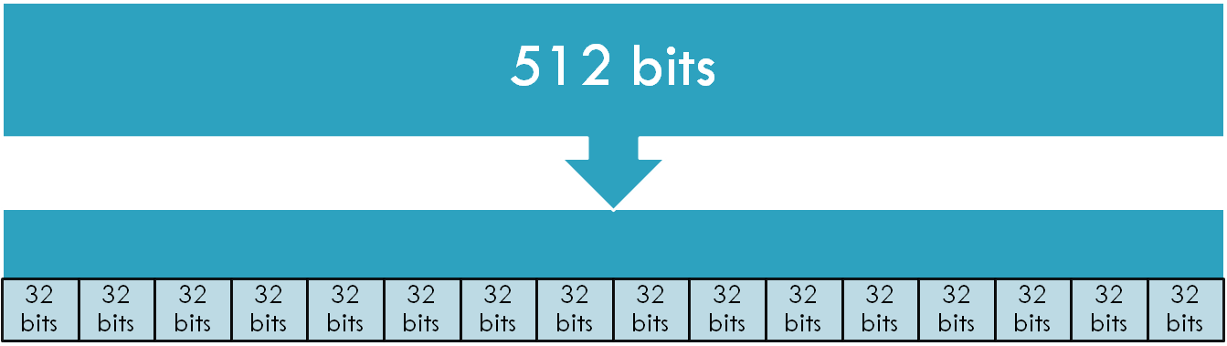
Step-5 Process blocks
5.1 – Copy the four variables (32*4 = 128)
5.2 – Divide the 512- bit block into 16 sub-blocks.
5.3 – Process each block with A, B, C, D.
Akash Mehta

Slide 37
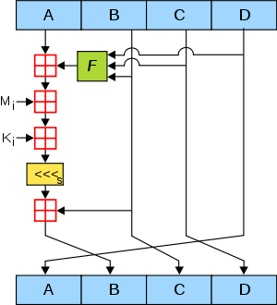
5.3 - Process each block with A, B, C, D.
Akash Mehta

Slide 38
Secure Hash Algorithm (SHA)
SHA-1 produces a hash value of 160 bits.
SHA is designed to be computationally infeasible to:
  Obtain the original message
  Find two message producing the same MD.
Akash Mehta

Slide 39
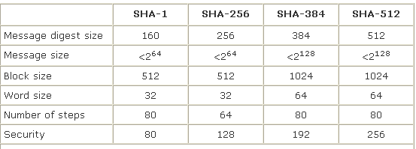
Types(Versions) of SHA
Akash Mehta

Slide 40
Algorithm
Step-1 Padding
Step-2 Append length
Step-3 Divide the input into 512-bit blocks.
Step-4 Initialize chaining variables (5 varibles)
Step-5 Process blocks
Akash Mehta

Slide 41
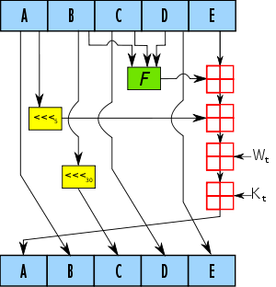
5.3- Process each block with A, B, C, D, E.
Akash Mehta

Slide 42
Comparison of MD5 & SHA-1
Points of Discussion | MD5 | SHA-1
MD length in bits | 128 | 160
Attack try to find MD | 2¹²⁸ | 2¹⁶⁰
Attack try to find two messages producing same message digest | 2⁶⁴ | 2⁸⁰
Speed | Faster | Slower
Akash Mehta

Slide 43
RACE Integrity Primitives Evaluation Message Digest (RIPEMD-160)
RIPEMD is a cryptographic hash based upon MD4. It's been shown to have weaknesses and has been replaced by RIPEMD-128 and RIPMD-160. These are cryptographic hash functions designed by Hans Dobbertin, Antoon Bosselaers, and Bart Preneel.
RIPEMD-160 produces a hash of the same length as SHA1 but is slightly slower. RIPEMD-128 has been designed as a drop-in replacement for MD4/MD5 whilst avoiding some of the weaknesses shown for these two algorithms. It is about half the speed of MD5.
Akash Mehta

Slide 44
HMAC(Hash-Based MAC)
HMAC has been chosen as a security implementation for Internet Protocol (IP) and Secure Socket Layer(SSL), widely used in internet.
The fundamental idea of HMAC is to reuse the existing MD5 or SHA-1.
Akash Mehta

Slide 45
Original message
Existing MD5 or SHA-1
MD
Encrypt
HMAC
K
Akash Mehta

Slide 46
How HMAC works?
MD- Message Digest/ Hash function
M – Input message
ipad- A string 00110110 repeated b/8 times
opqd- A string 01011010 repeated b/8 times
Akash Mehta

Slide 47
How HMAC works?
Step-1 Make the length of K equal to b
  Length K<b (Append 0 – left side)
  Length K=b (Step -2)
  Length K>b (Hash K reduce its length to b)
Step- 2 XOR K with ipad to produce S1
Step -3 Append M to S1
Step -4 Message Digest algorithm
Step -5 XOR K with opad to produce S2
Step -6 Append H toS2
Message Digest Algorithm
Akash Mehta

